Slide 1
Employee Data Analysis using Excel
STUDENT NAME: M.SUBHASHINI
REGISTER NO:312203007
NM ID:FD57D81A6294F2A92D746E213
DEPARTMENT:COMMERCE[B.COM]
COLLEGE: ASAN MEMORIAL COLLEGE OF ARTS AND SCIENCE

Slide 2

PROJECT TITLE
Employee Performance Analysis using Excel

Slide 3


AGENDA
Project Overview
End Users
Our Solution and Proposition
Dataset Description
Modelling Approach
Results and Discussion
Problem Statement
Conclusion
3/21/2024 Annual Review

Slide 4

PROBLEM STATEMENT
Ideally, performance evaluations provide a stepping-stone for the employee and supervisor to identify and discuss areas where performance can be improved. It can also be an important opportunity for employee and manager expectations to be reinforced or clarified.

Slide 5

PROJECT OVERVIEW
Employee performance analytics is the act of analyzing HR data to measure how your employees are performing against KPIs. These KPIs are role-specific performance goals, metrics, or standards that are tied to your larger business goals.

Slide 6
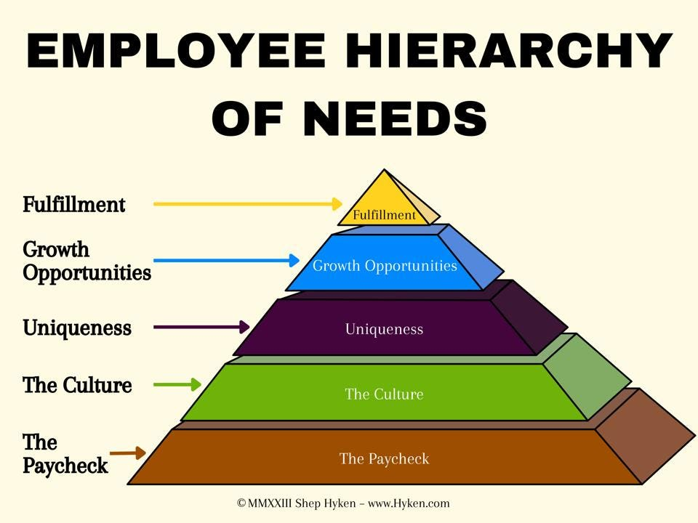

WHO ARE THE END USERS?

Slide 7

OUR SOLUTION AND ITS VALUE PROPOSITION
FILTERING
COLOURING
PIVOT TABLE
SLICER
CONDITIONAL FORMATING

Slide 8
Dataset Description
EMPLOYEE DATASET COLLECT FROM IBM DASHBOARD
THERE ARE 26 FEATURES IN THE DATASET
ONLY 7 FEATURES WE COLLECT IN THE DATA SET
1ST FEATURE WE COLLECT IN THE DATA SET IS EMPLOYEE ID
2ND FEATURE IS FIRST NAME
3RD FEATURE IS TITLE
4TH FEATURE IS SUPERVISOR
5TH FEATURE IS EMPLOYEE CONTRACT
6TH FEATURE IS DEPARTMENT TYPE
AND THE LAST DATA WE COLLECT IN THE DATA SET IS GENDER

Slide 9
MODELLING
DATA COLLECTION
1. DATA SET DOWNLOAD FROM EDUNET DASHBOARD
2. EMPLOYEE PERFORMANCE ANALYSIS USING EXCEL
FEATURES COLLECTING
1. THERE ARE 26 FEATURES IN THE DATA
2. EMPLOYEE ID,FIRST NAME,LAST NAME,START DATE,EXIT DATE ,ETC…..
3. IN THIS 26 FEATURES WE COLLECT ONLY 7 FEATURES IN THE DATA SET
4. EMPLOYEE ID,FIRST NAME,TITLE,SUPERVISOR,EMPLOYEE CONTRACT,DEPARTMENT TYPE AND GENDER
9

Slide 10
DATA CLEANING
IF THE DATA CLEANING WE ALSO USE CONDITIONAL FORMATING
IDENTIFYING THE MISSING VALUES
USING CONDITIONAL FORMATING AND HIGHLIGHTING BY COLOURS
REMOVE THOSE BLANK VALUES WITH USING FILTER
SUMMARIZING (PIVOT TABLE)
COLLECT THE DATA FROM EXCEL SHEET
SUMMARIZE THE VALUES USING PIVOT TABLE
A PARTICULAR DATA IS SET TO BE IN THE ROW,FILTER AND VALUE
AND WE USE SLICER TO SELECT THE FIELD TO USE FOR FILTERING LIKE SUOERVISOR ETC..

Slide 11
RESULTS
11

Slide 12
conclusion
HIGHLIGHT THE EMPLOYEES STRENGTHS ,AREA FOR IMPROVEMENTS,
AND ANY PATTERNS OBSERVED
2. THE MEDIUM LEVEL OF EMPLOYEES ARE HIGH
3. SO WE CAN IMPROVE THE VERY HIGH AND HIGH LEVEL OF WORKERS
4. WE PROVIDE BONUS, INCENTIVES ETC..FOR WORKERS

